Slide 1
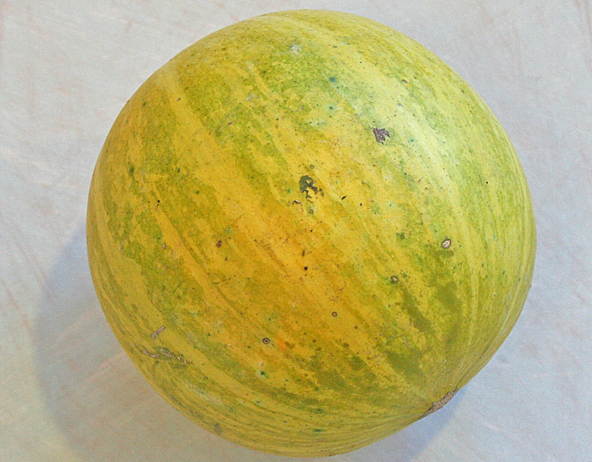
Inflorescences, Fruits & Seeds
Judd et al pp. 85-113

Slide 2
Inflorescence
“The shoot system which serves for the formation of flowers and which is modified accordingly.”
Types of inflorescence differ in the arrangement of flowers on the plant.
Inflorescence type helps with routine identification.

Slide 3
Two Types of (Angiosperm) Inflorescences
Determinate Inflorescences– main axis ends in a flower which terminates growth of the axis and the flowering sequence usually begins at the top of the cluster of flowers.
Indeterminate Inflorescences– the growing point produces only lateral flowers, continues to elongate and the flowering sequence usually begins at the base.

Slide 4
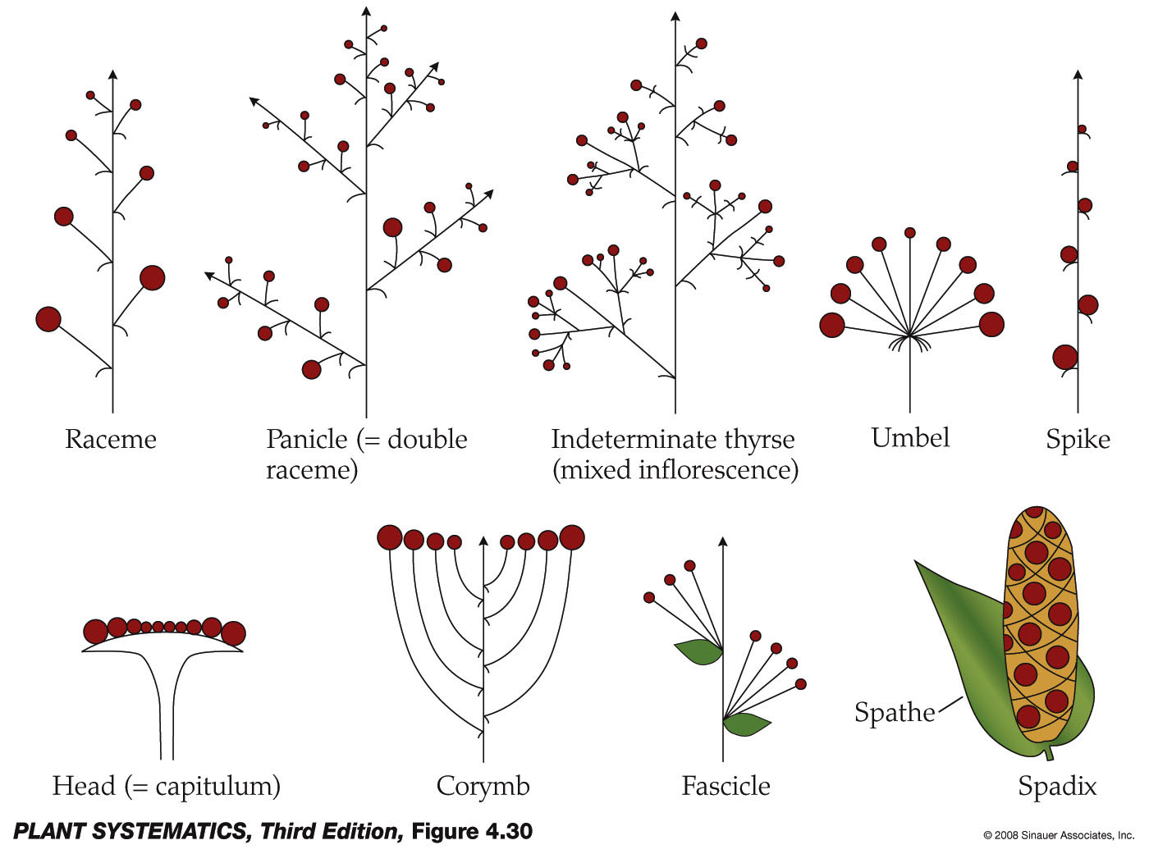
Common Types of Indeterminate Inflorescences
An indeterminate thyrse has an indeterminate main axis and determinate side branches.

Slide 5
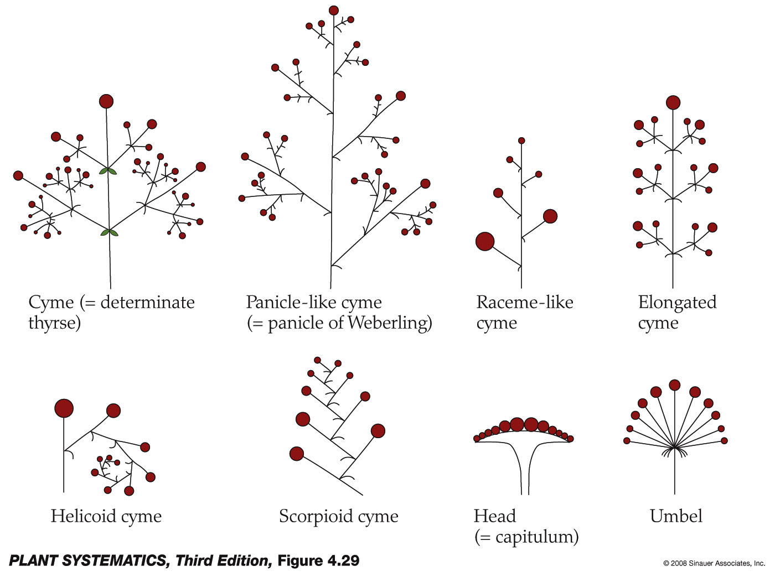
Common Kinds of Determinate Inflorescences
* Will look like they are flowering from the bottom up and seem indeterminate!
*
*
*
To summarize this slide: the main determinate inflorescence is a cyme. Heads and Umbels can be determinate or indeterminate.

Slide 6
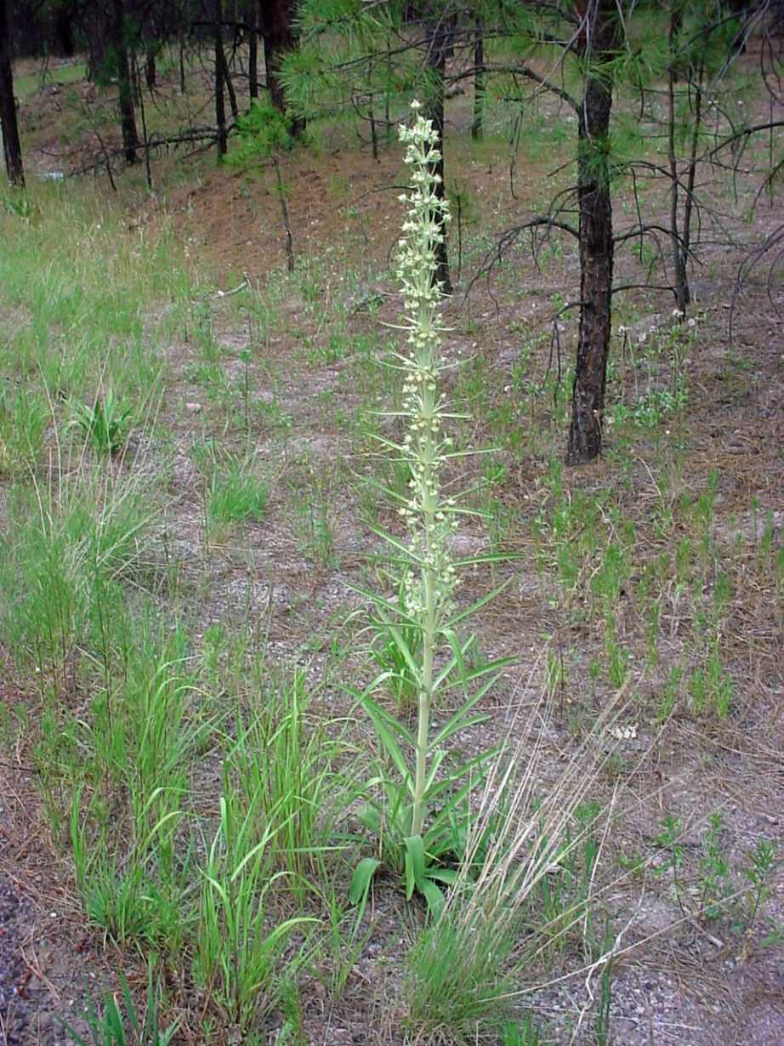
Determinate Inflorescence– Cyme, Frasera speciosa

Slide 7
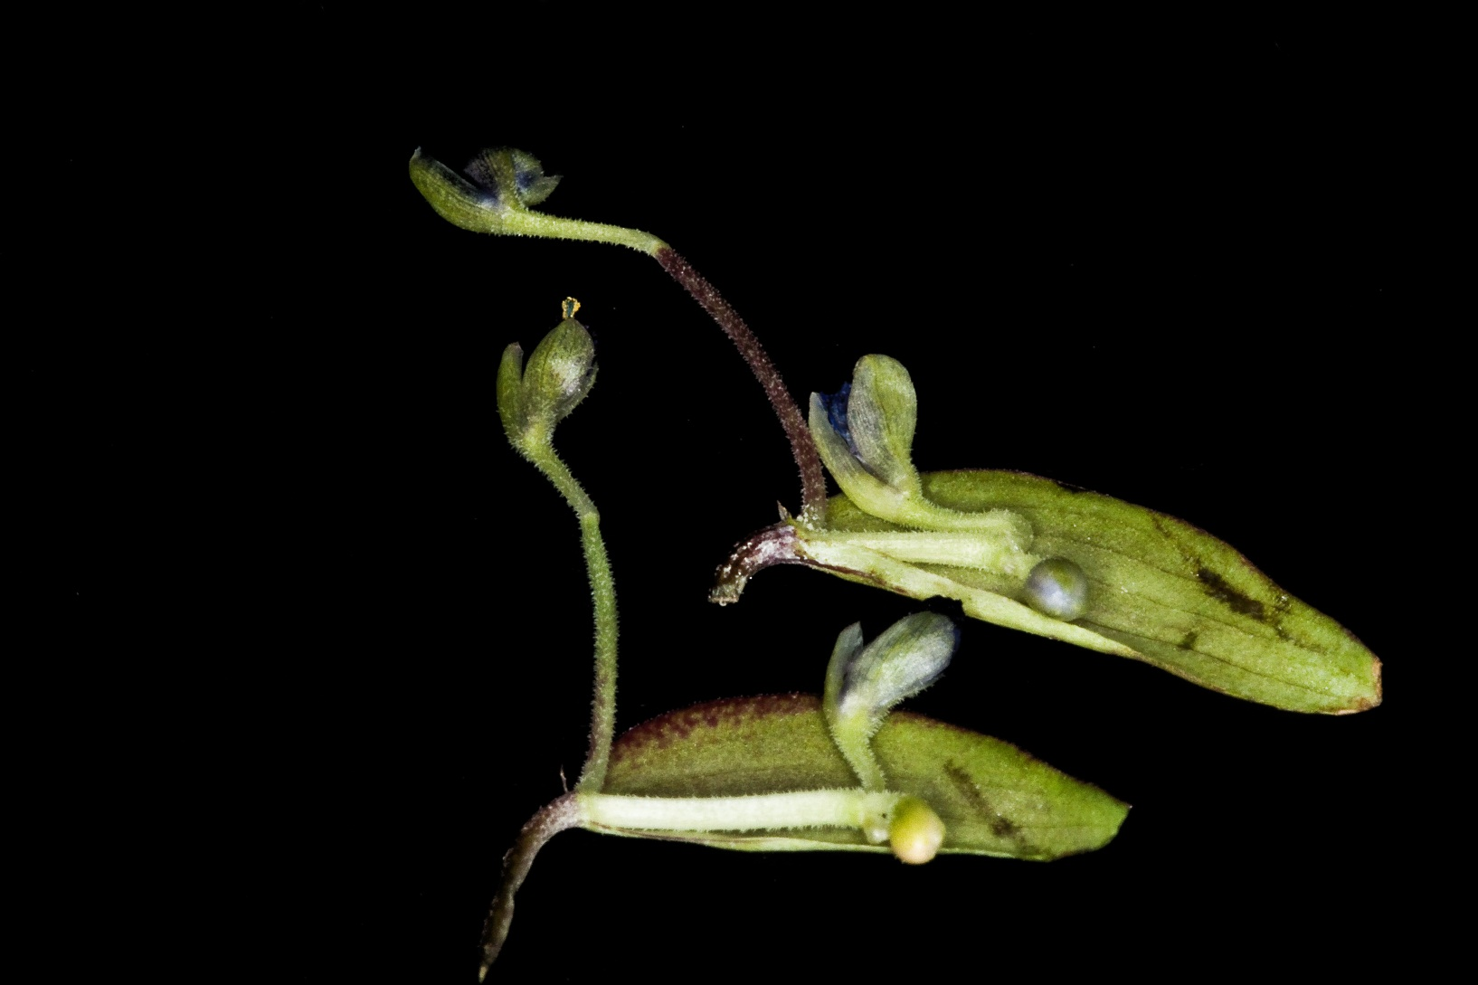
Determinate Inflorescence– Cyme, Commelina dianthifolia
Remember that the shoot is terminated by a flower.

Slide 8
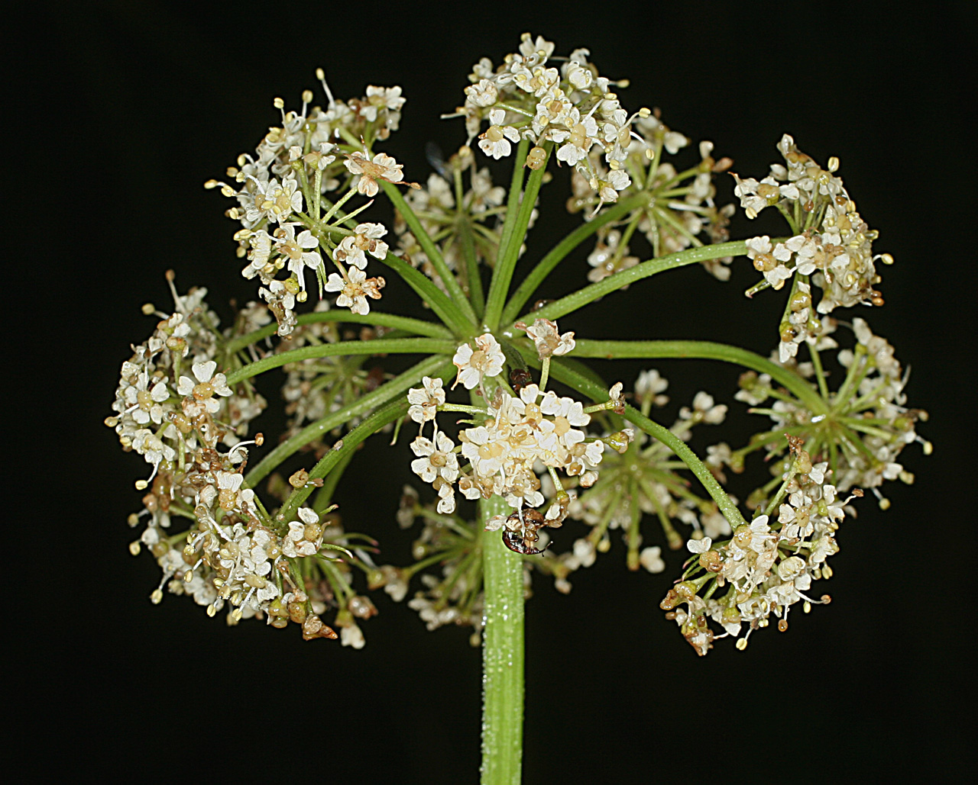
Determinate Inflorescence– Umbel, Ligusticum porteri

Slide 9
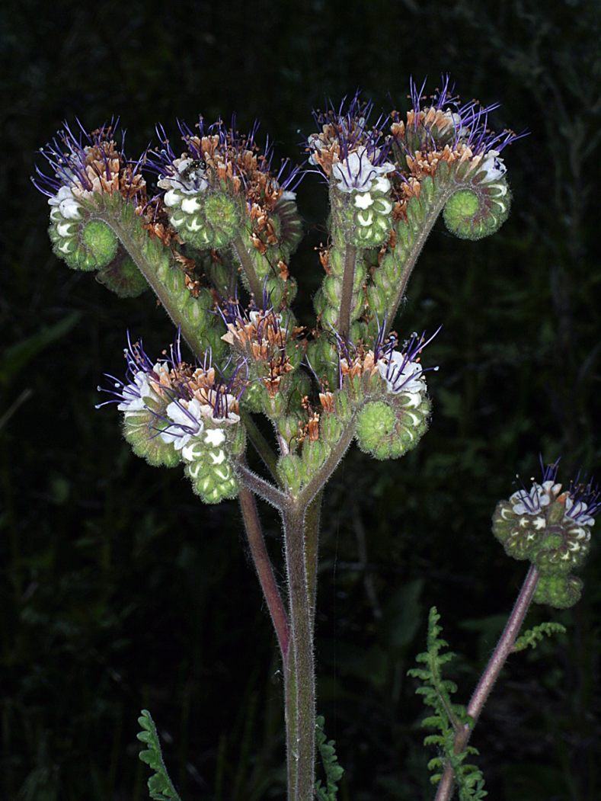
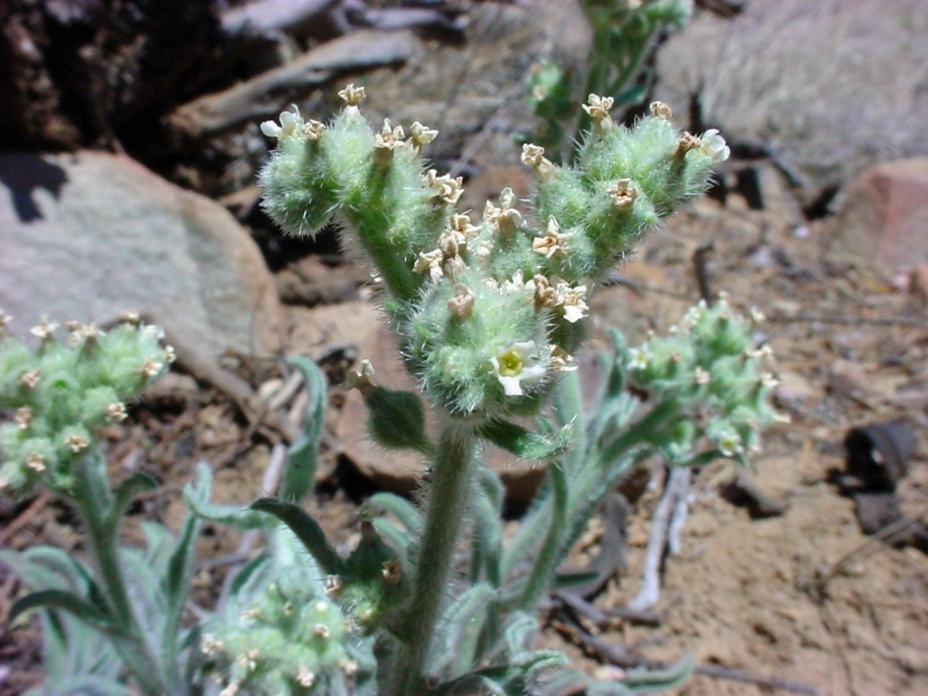
Determinate Inflorescence– Scorpioid Cyme (These frequently look like they are indeterminate)
Phacelia neomexicana (Hydrophyllaceae)
Cryptantha cinerea (Boraginaceae)

Slide 10
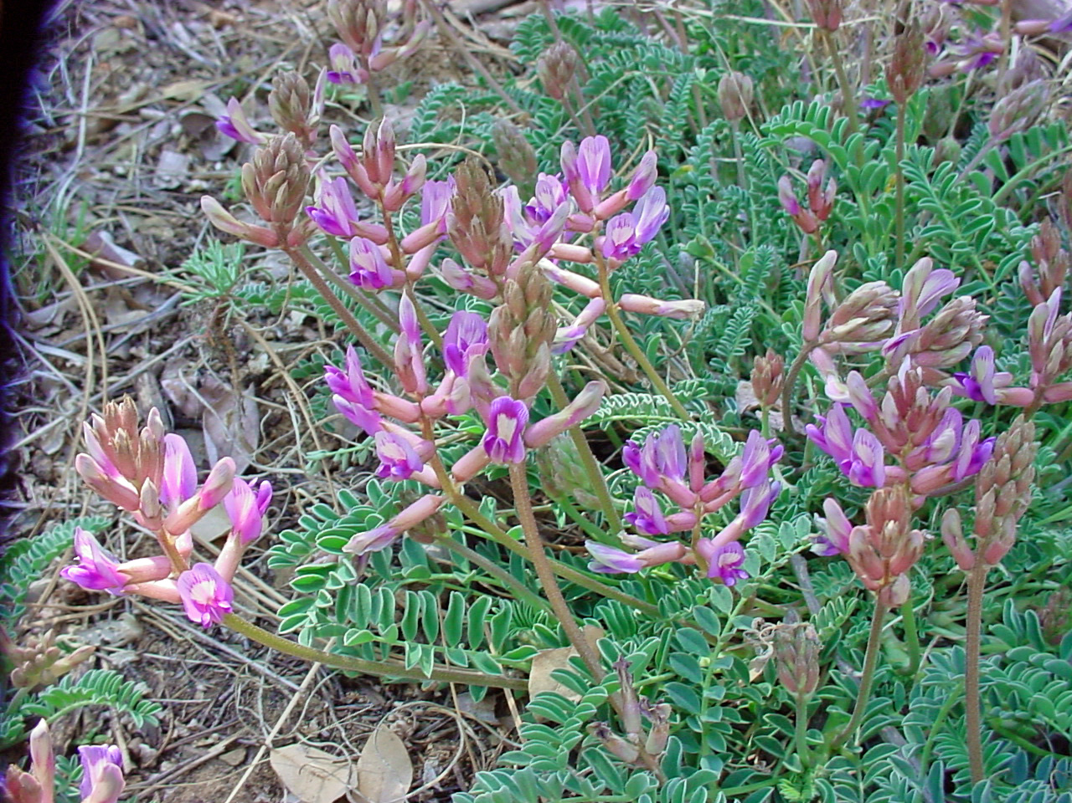
Indeterminate Inflorescence– Spike, Astragalus tephrodes

Slide 11
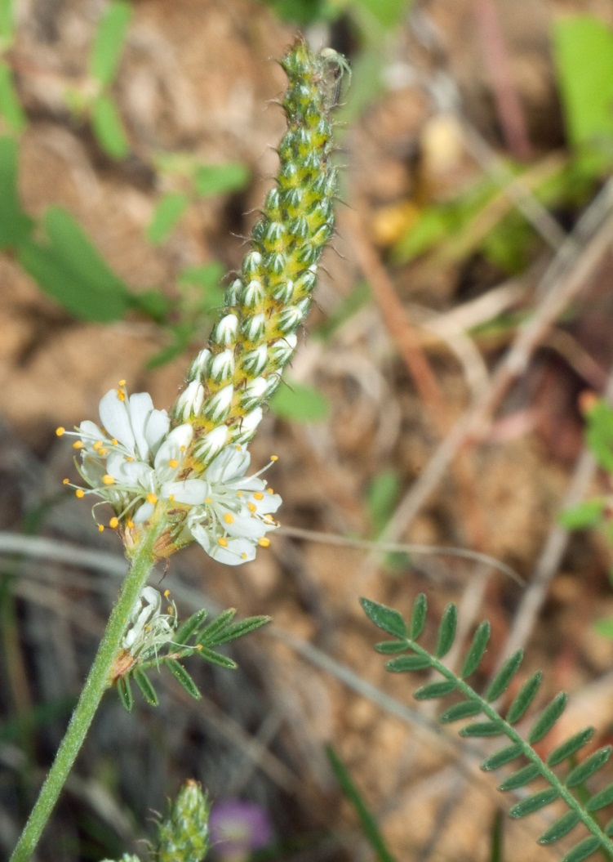
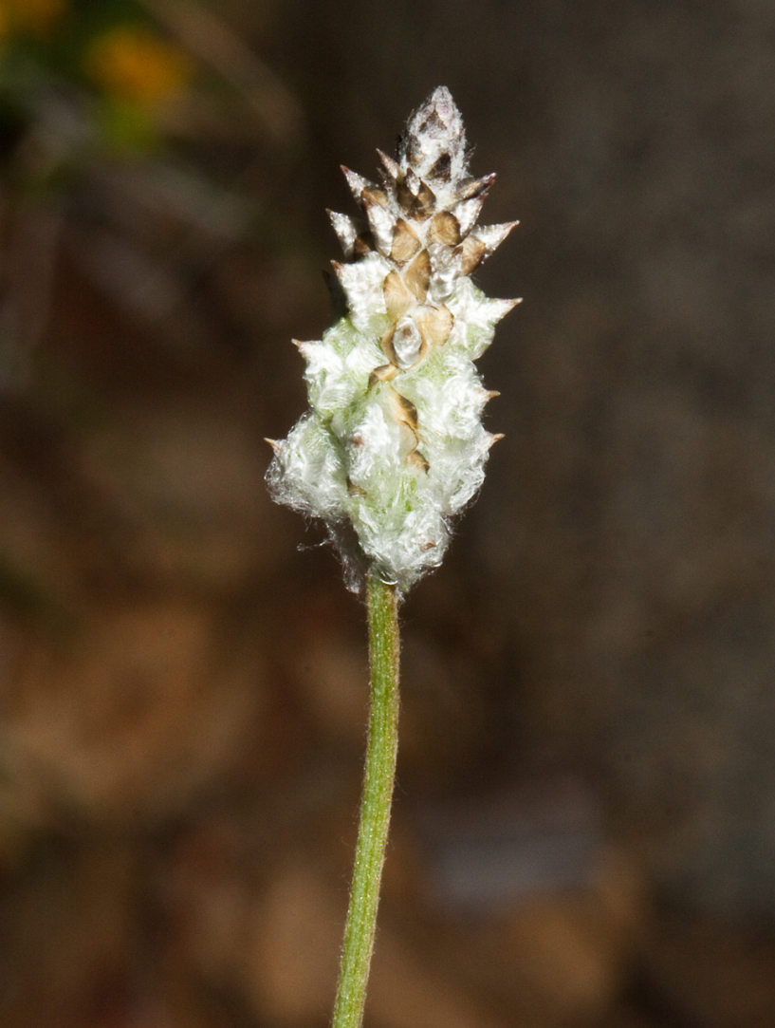
Indeterminate Inflorescence-- Spike
Dalea albiflora (Fabaceae)
Froelichia gracilis (Amaranthaceae)

Slide 12
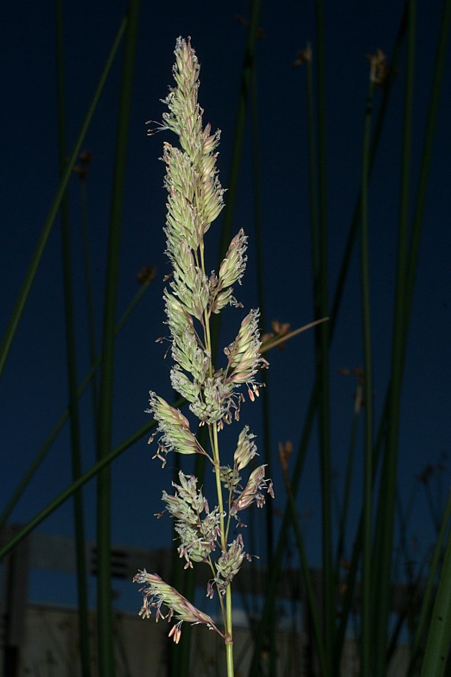
Indeterminate Inflorescence– Panicle, Phalaris arundinacea

Slide 13
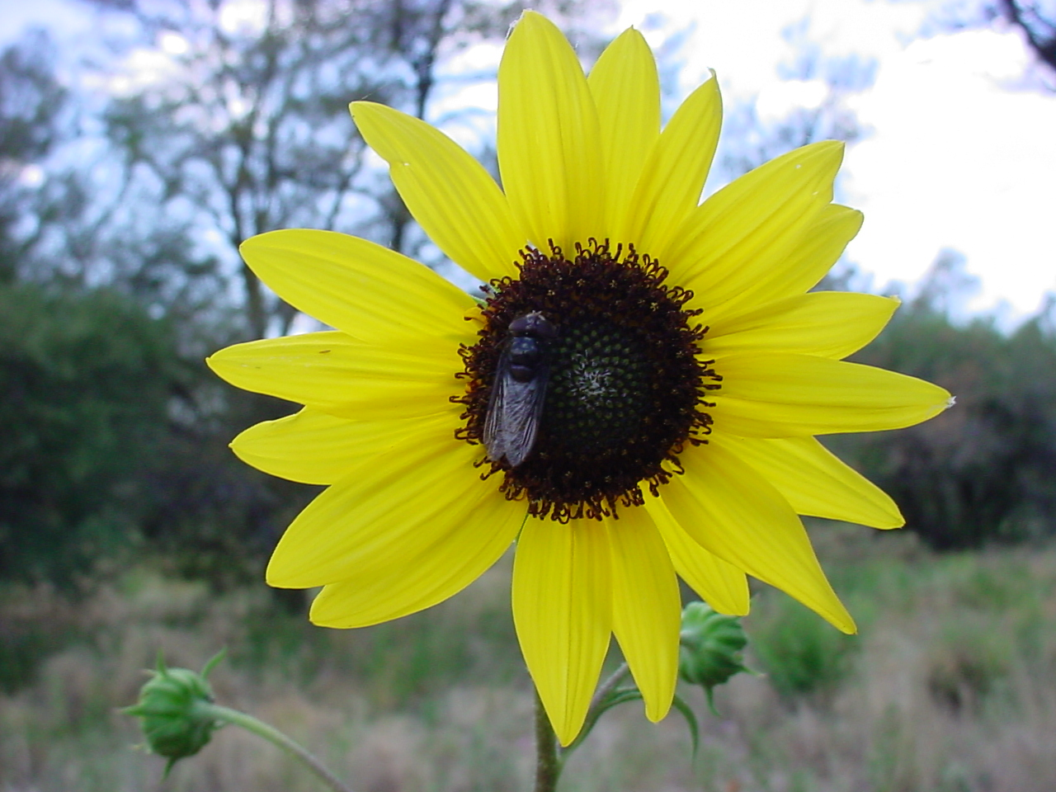
Indeterminate Inflorescence– Head, Helianthus annus (heads can also be determinate)

Slide 14
Fruit Types
A fruit is a matured OVARY with fused accessory structures (hypanthium or perianth parts).
Many different types of fruits
Differ based on texture of the pericarp (fruit wall– fleshy or dry), pattern of dehiscence (how it opens), size and shape, and carpel number.

Slide 15
Fruits Can Be Confusing! Beware common names…
A Coffee “Bean” is a Drupe!
A Walnut is a Drupe!
A Strawberry is an aggegate of Achenes!
A Raspberry is an aggregate of Drupes!
A Peanut is a Legume!
A Coconut is a Drupe!
Pine “nuts” are Seeds!
Juniper “berries” are Cones!

Slide 16
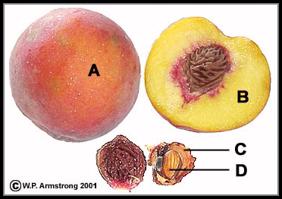
Pericarp (mature ovary wall of the fruit)
Endocarp (C) (inner layer as in the pit or stone of a cherry or peach
Mesocarp (B) middle layer usually fleshy
Exocarp (A) outer layer usually a firm “skin”
Seed (D)

Slide 17
Fruits– Indehiscent & Fleshy
Berry– an indehiscent, fleshy fruit with one or a few to many seeds.
Drupe– an indehiscent, fleshy fruit in which the outer part is soft and the center contains a hard pit surrounding a seed.
Pome– an indehiscent, fleshy fruit in which the outer part is soft and the inner part contains papery structures enclosing the seeds…many Rosaceae. Ovary surrounded by fleshy hypanthium.

Slide 18
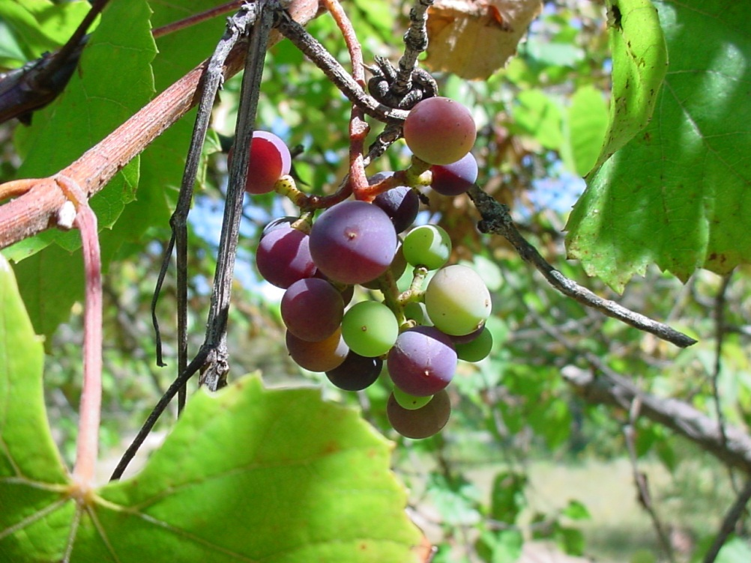
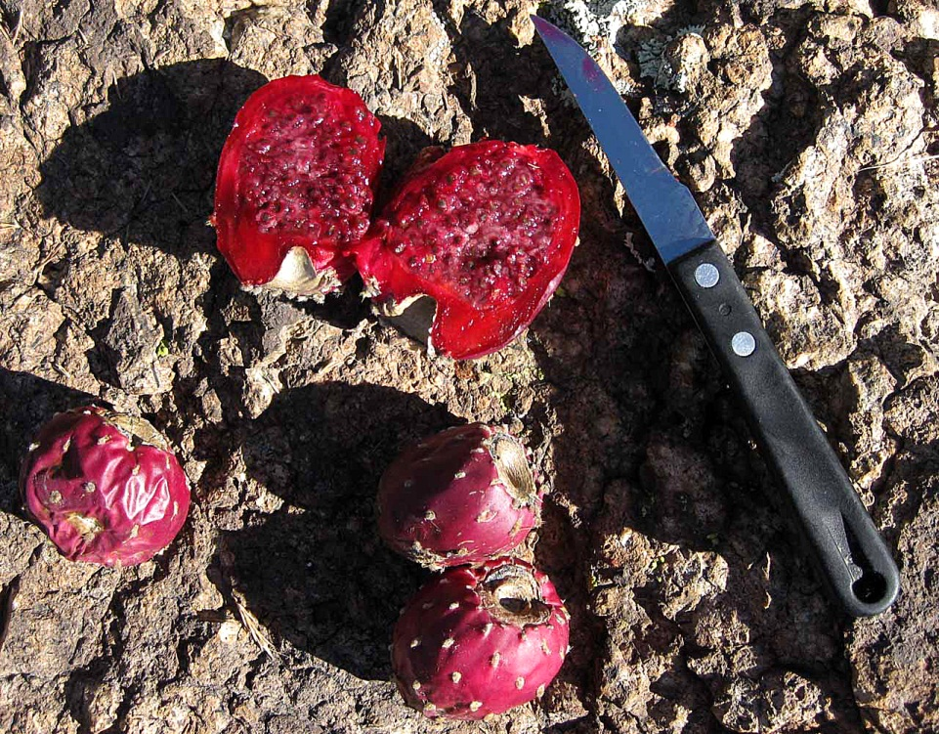
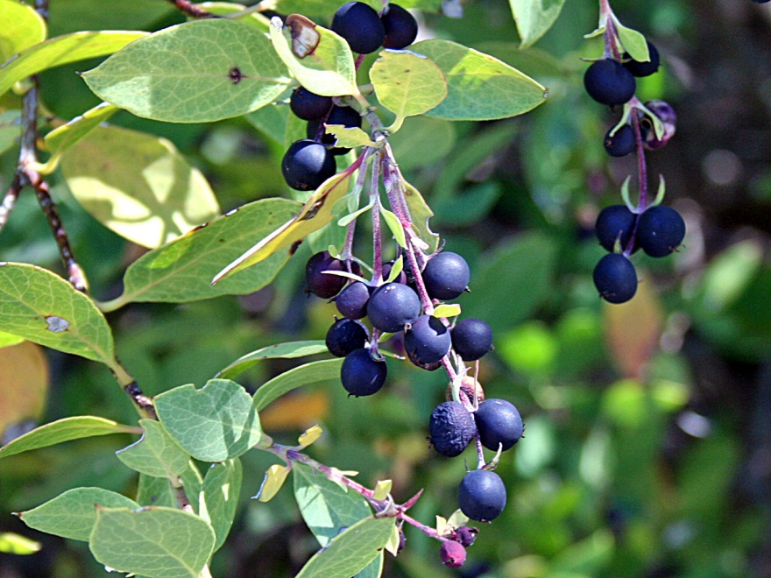
Berries

Slide 19
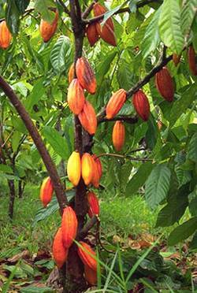
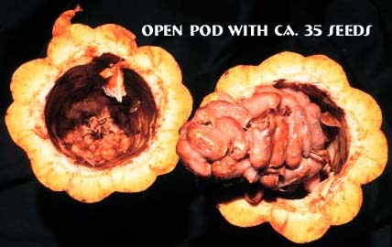
My Favorite Berry!
Theobroma cacao (Malvaceae)

Slide 20
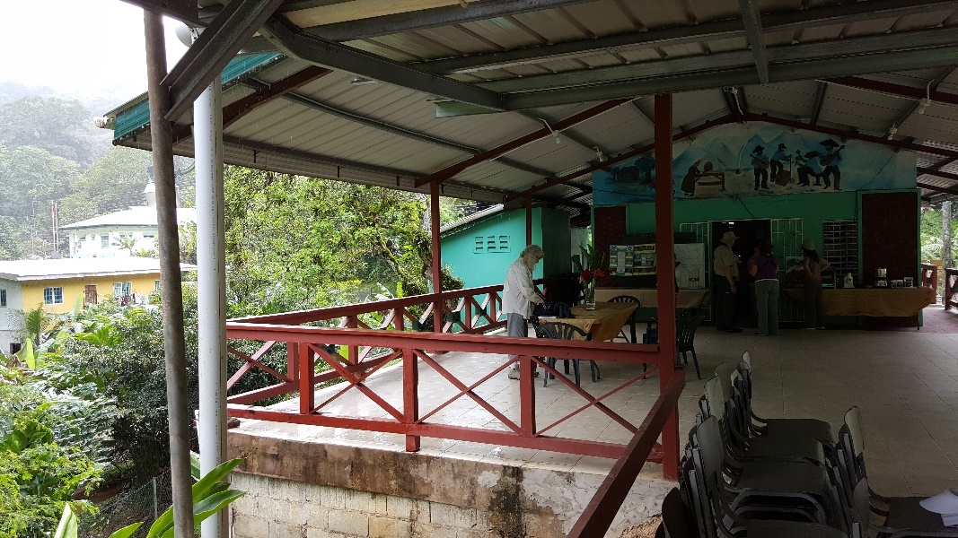
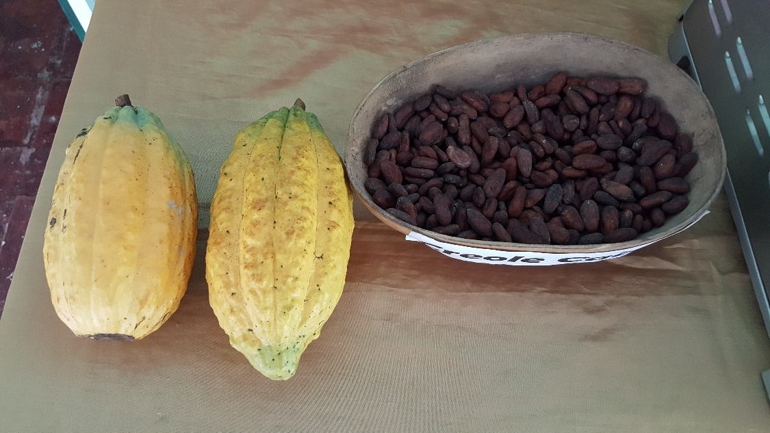
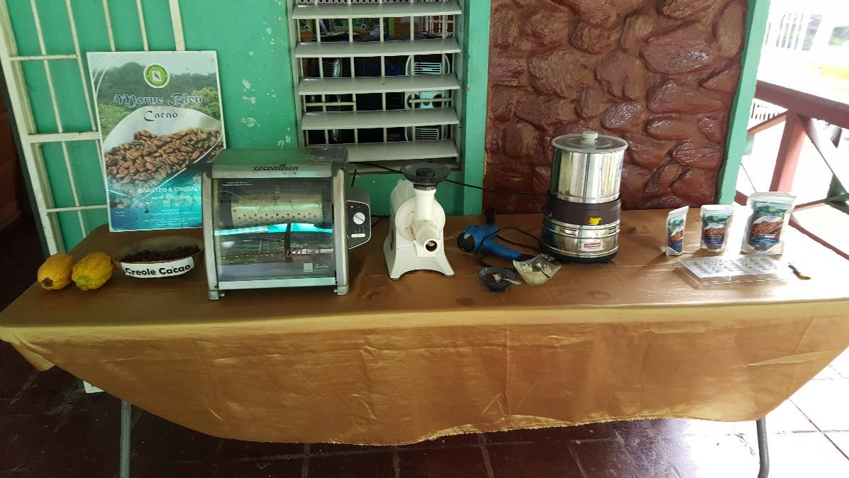
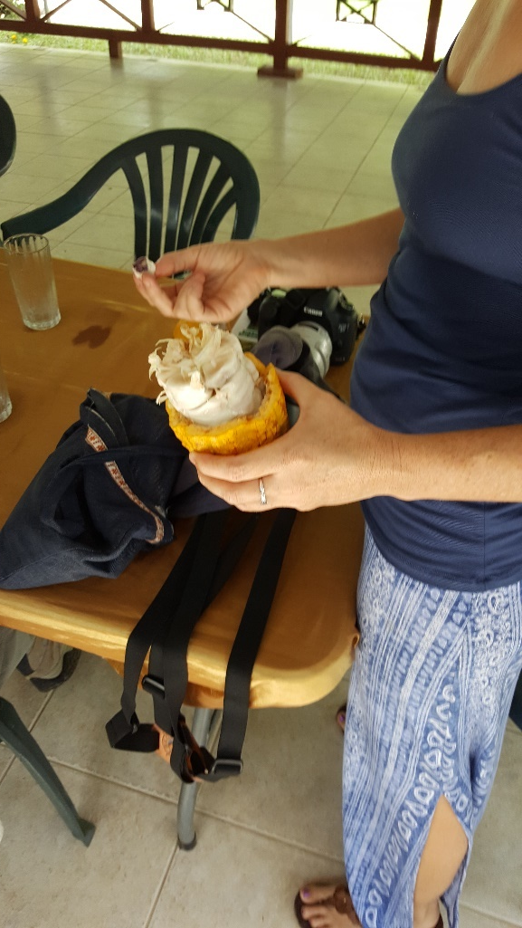
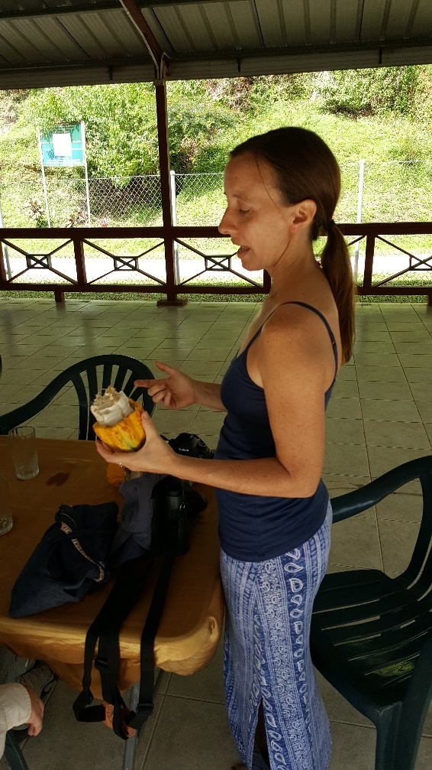
Chocolate Factory at Brasso Seco, Trinidad– our guide was Kelly, who came to Trinidad & Tobago from San Francisco as part of her graduate student research and decided to stay!

Slide 21
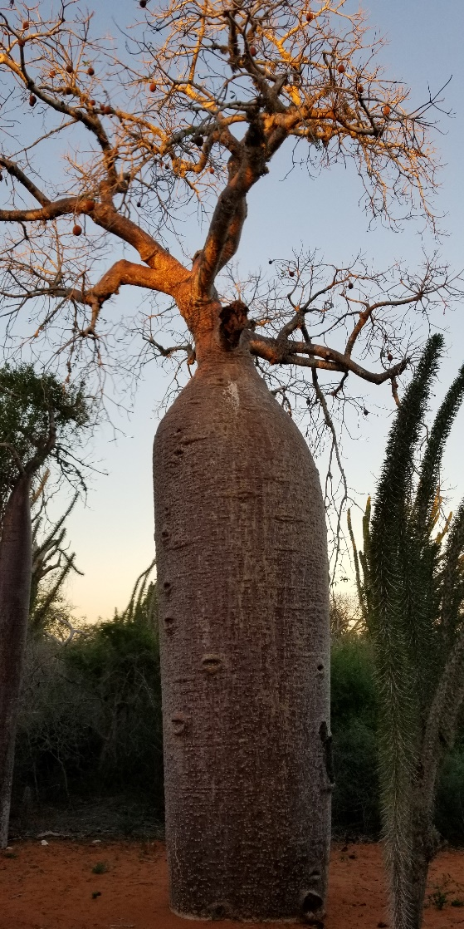
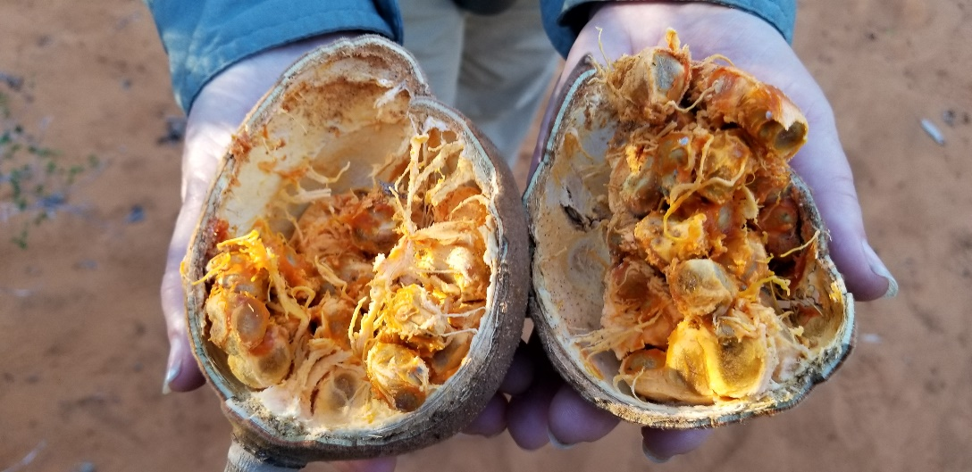
Tropical Plants Can Have Weird Fruits
The indehiscent fruit of the Baobab trees is fleshy inside with seeds that do not have a hard endocarp. It sounds like a berry, but the exocarp is a hard shell. Or a capsule, except that it is indehiscent. The name applied to this kind of fruit is called an “amphisarcum.”
Adansonia rubrostipa (Malvaceae)—Baobab tree

Slide 22
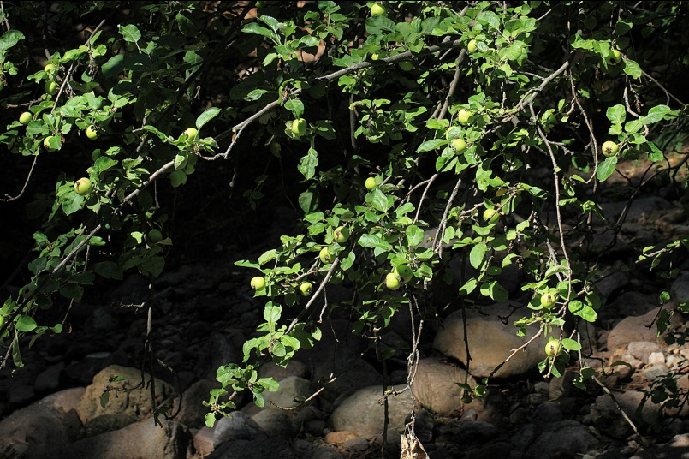
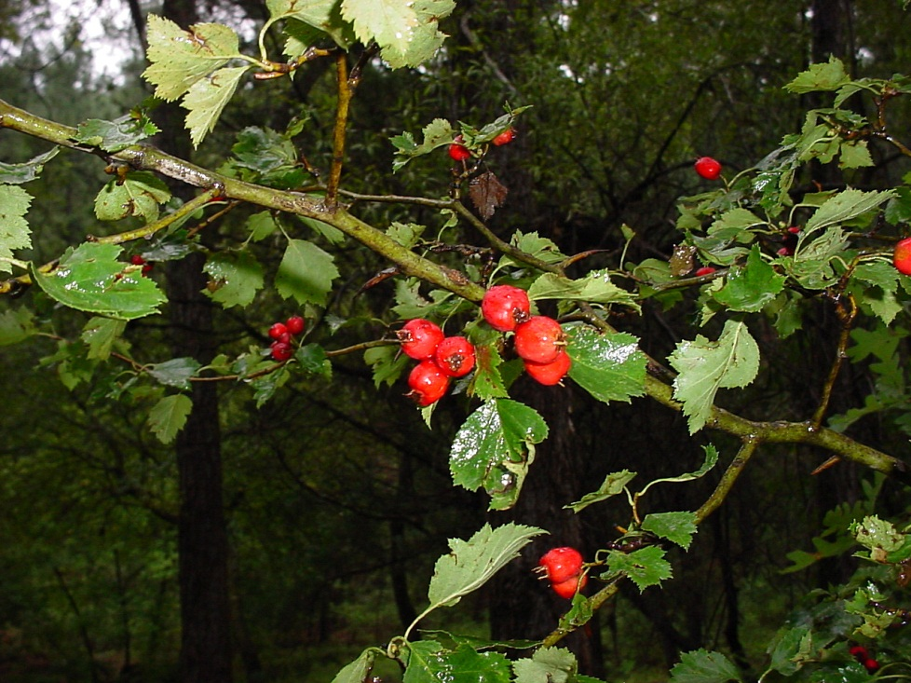
Special Berries-- Pomes

Slide 23
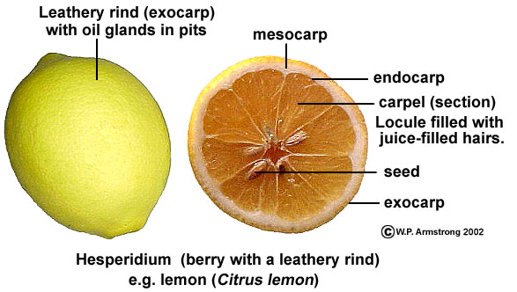
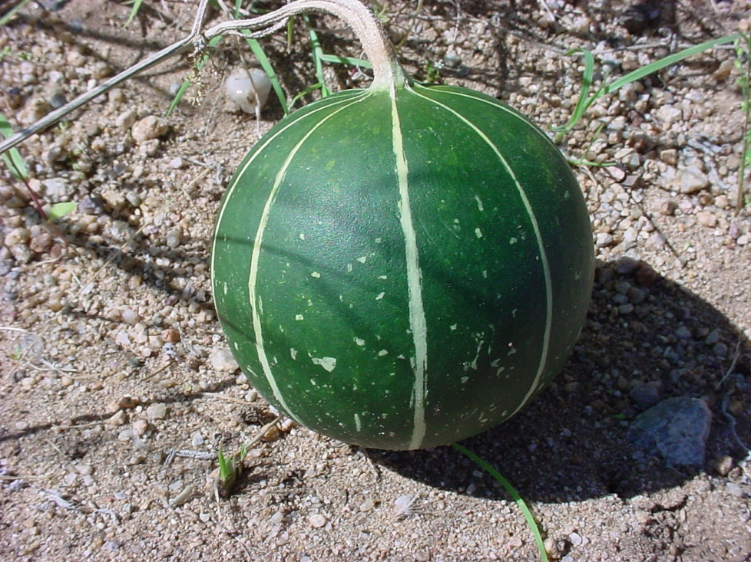
Other Special Berries
Hesperidium
Pepo

Slide 24
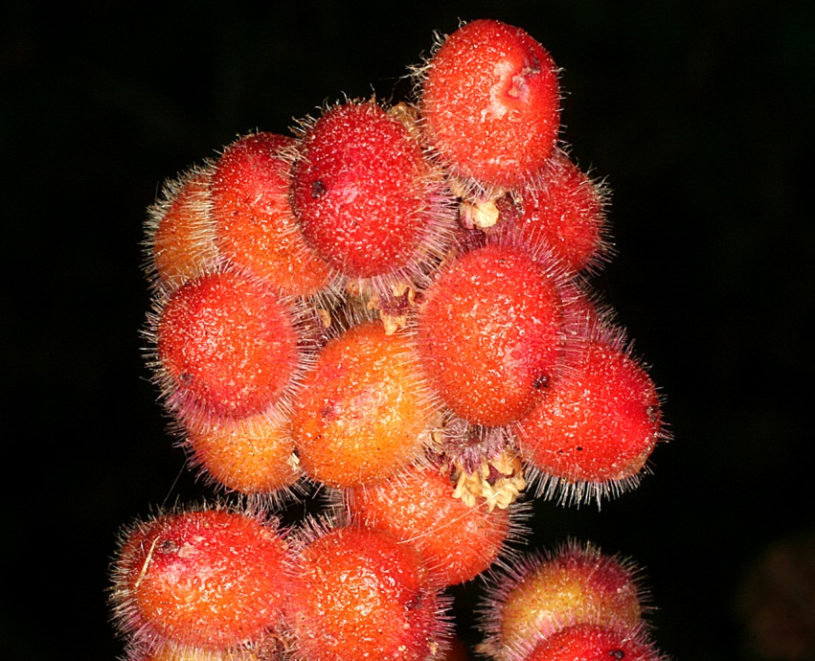
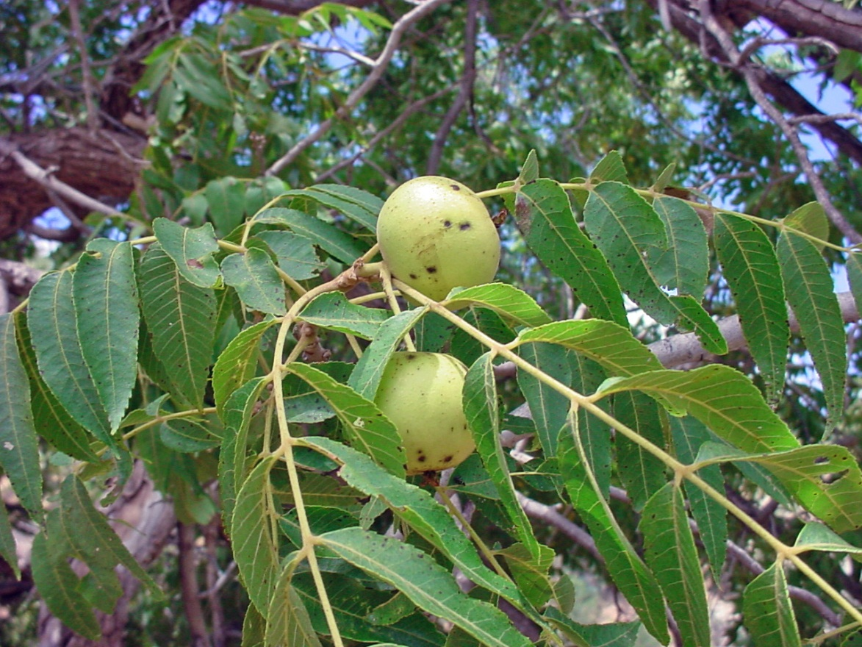
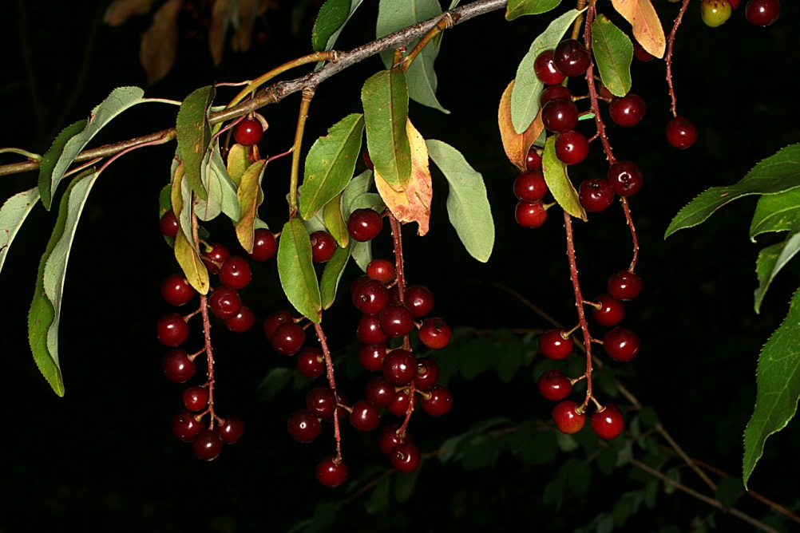
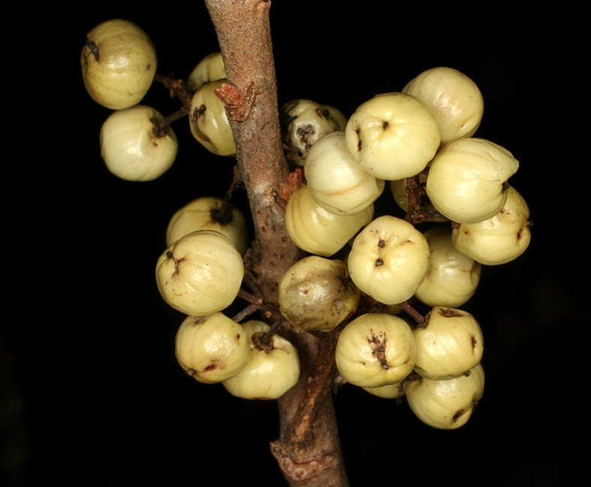
Drupes
Rhus trilobata
Juglans major
Prunus serotina
Toxicodendron rydbergii

Slide 25
Fruits– Indehiscent & Dry
Nut– fairly large, indehiscent dry fruit with thick wall surrounding a single seed.
Achene– fairly small, indehiscent dry fruit with a thin and close fitting wall surrounding a single seed. Seed attached to pericarp at one point.
Samara– winged, indehiscent dry fruit containing a single seed. (winged achene)

Slide 26
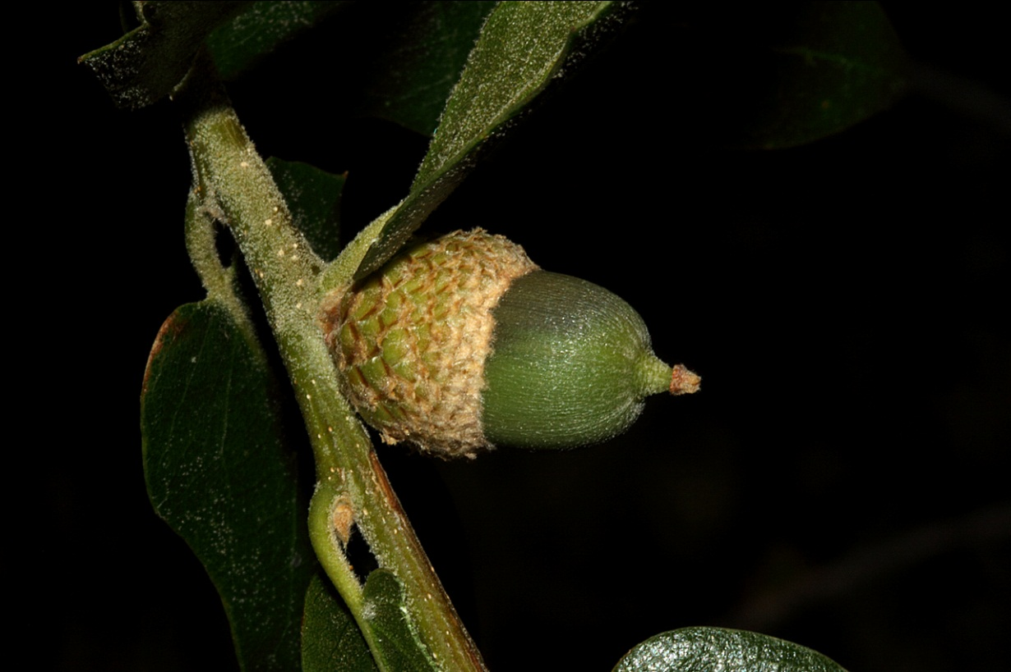
Nuts
Coconuts, walnuts, etc are drupes, not nuts in the strict sense!
Acorns are the only true nut I can think of in our area.

Slide 27
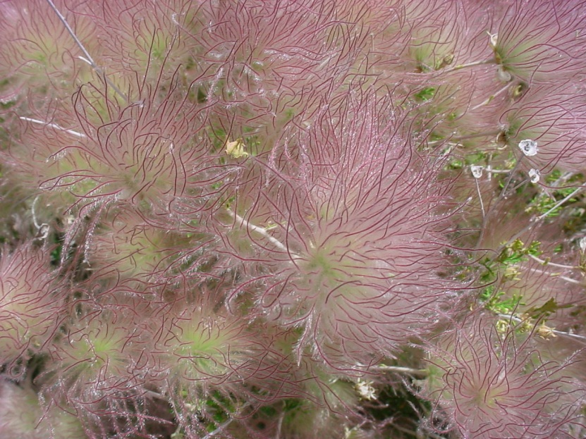
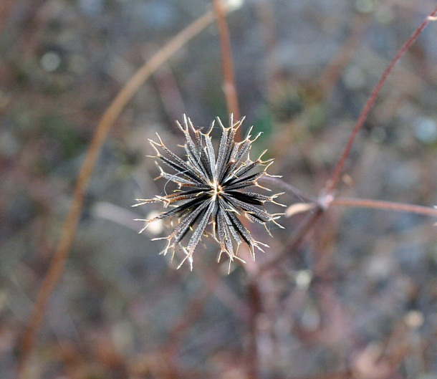
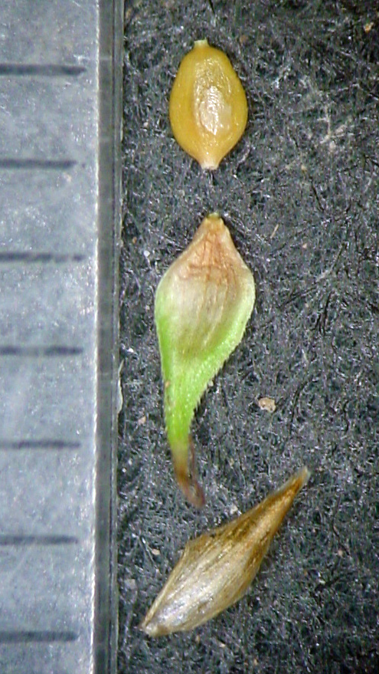
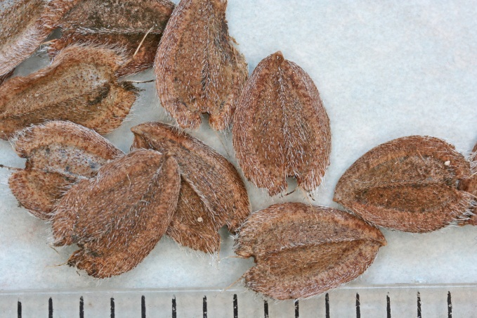
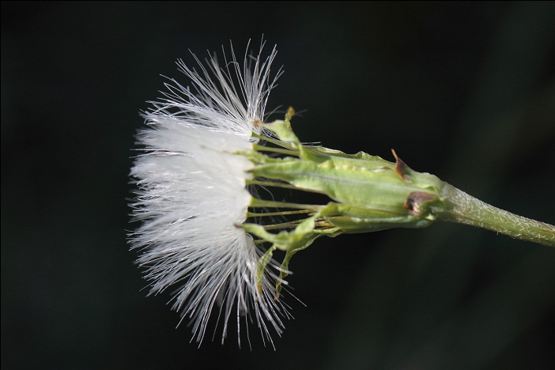
Achenes
Includes cypsela– achene with a parachute

Slide 28
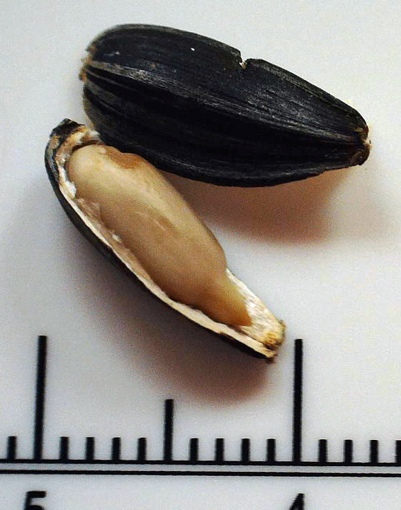
Helianthus achene
Achene– fairly small, indehiscent dry fruit with a thin and close fitting wall surrounding a single seed. Seed attached to pericarp at one point.

Slide 29
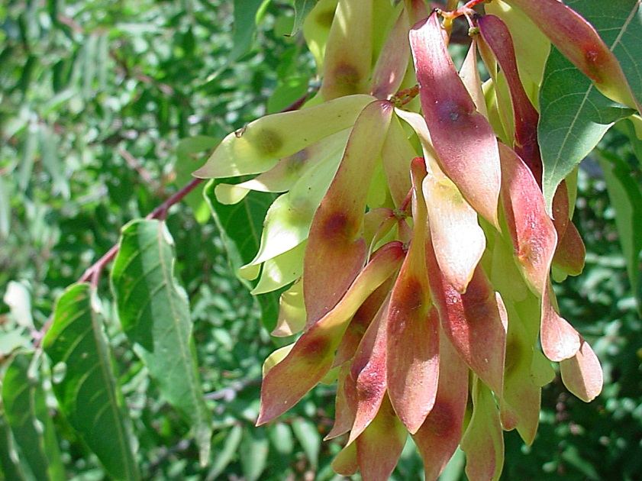
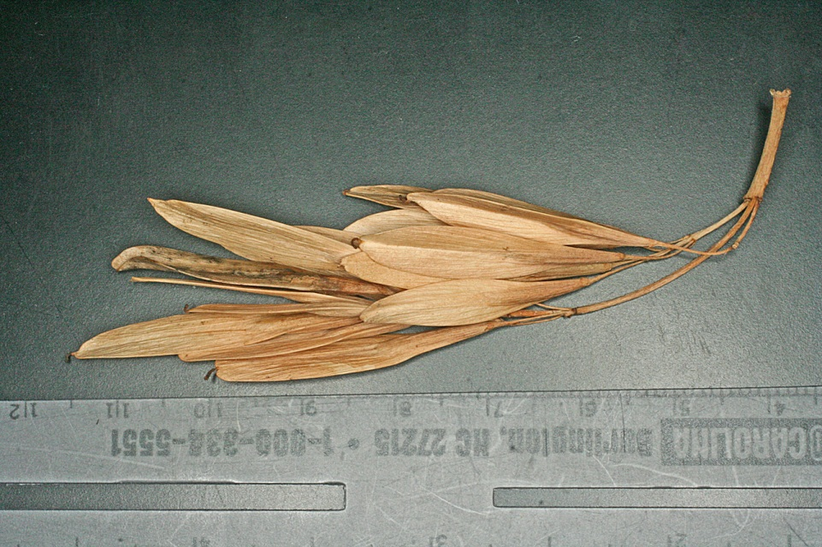
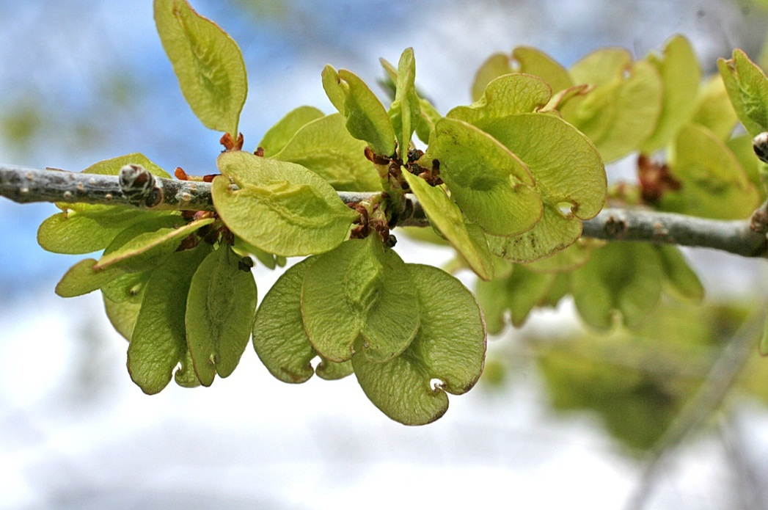
Samaras

Slide 30
Fruit Dehiscent, dry, one carpel
Follicle– a dry fruit that dehisces (opens) along a single longitudinal suture (slit).
Legume– a dry fruit the dehisces along two longitudinal sutures. Always ONE carpellate.

Slide 31
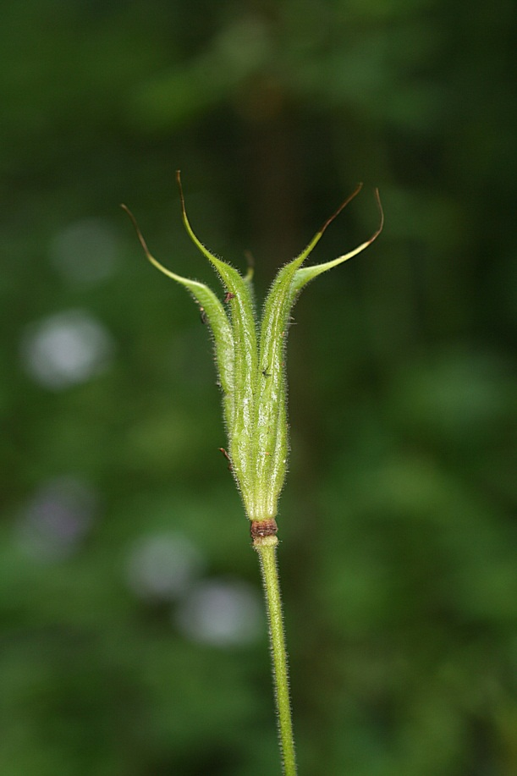
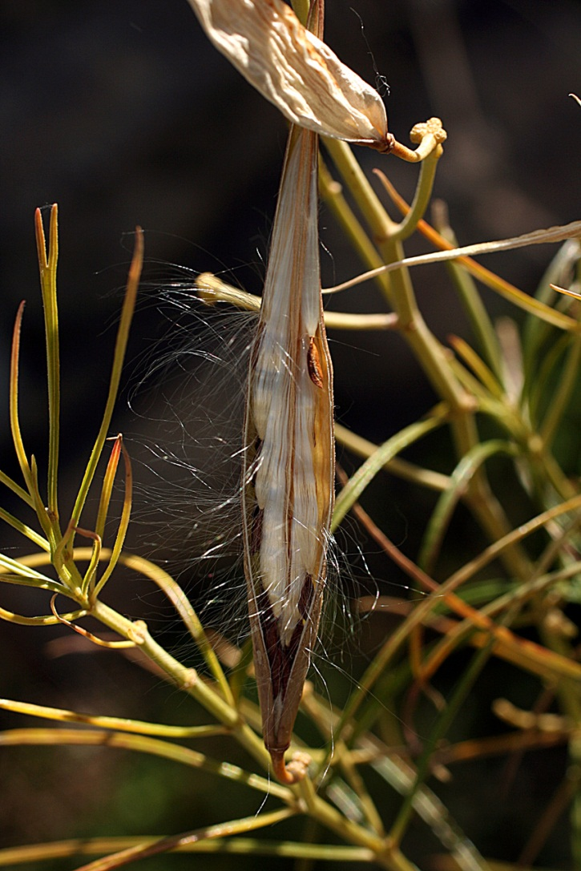
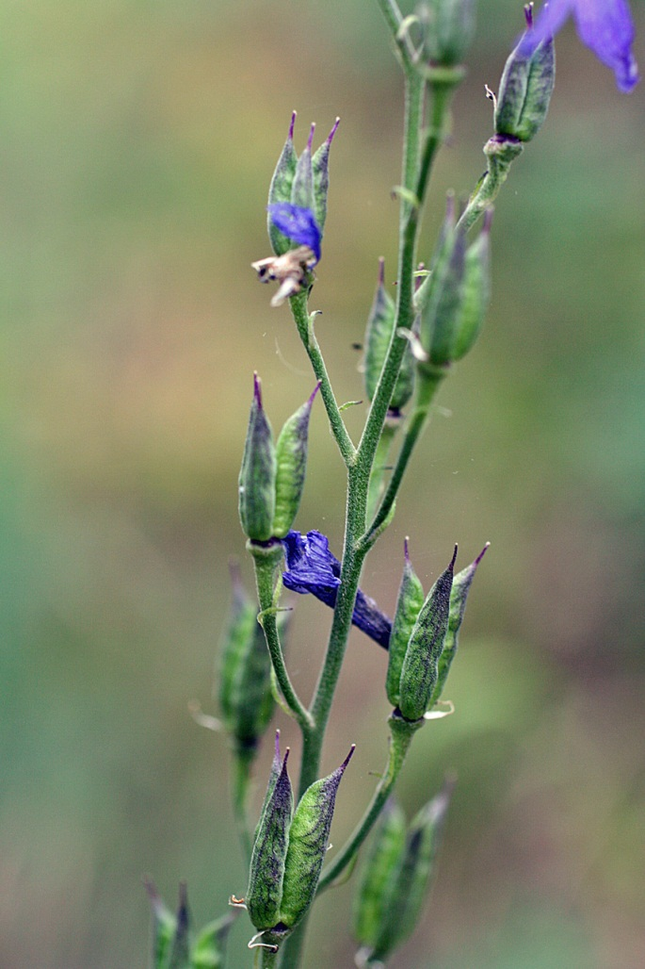
Follicles
Delphinium: aggregate of follicles
Aquilegia: aggregate of follicles
Aggregate: fruit that develops from several separate carpels of a single flower
Asclepias: a follicle

Slide 32
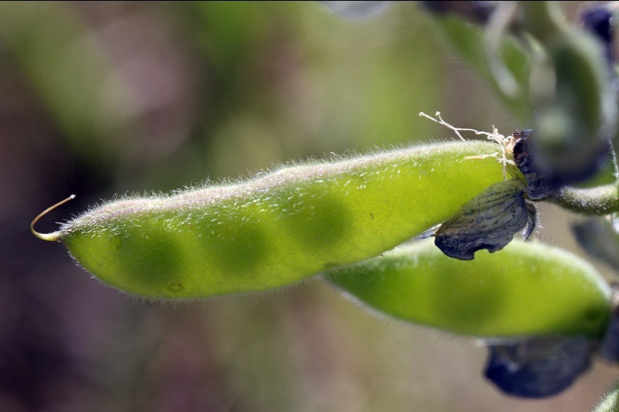
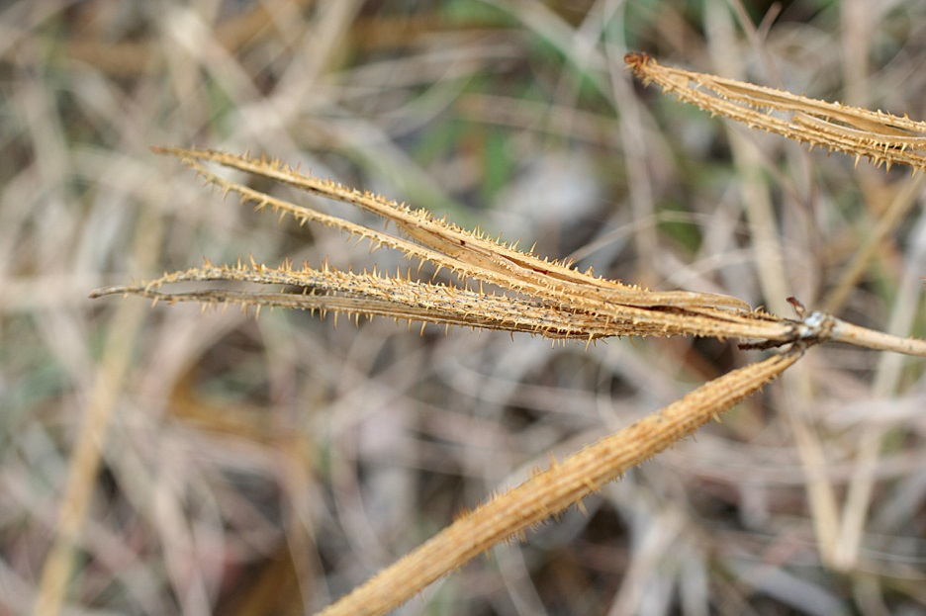
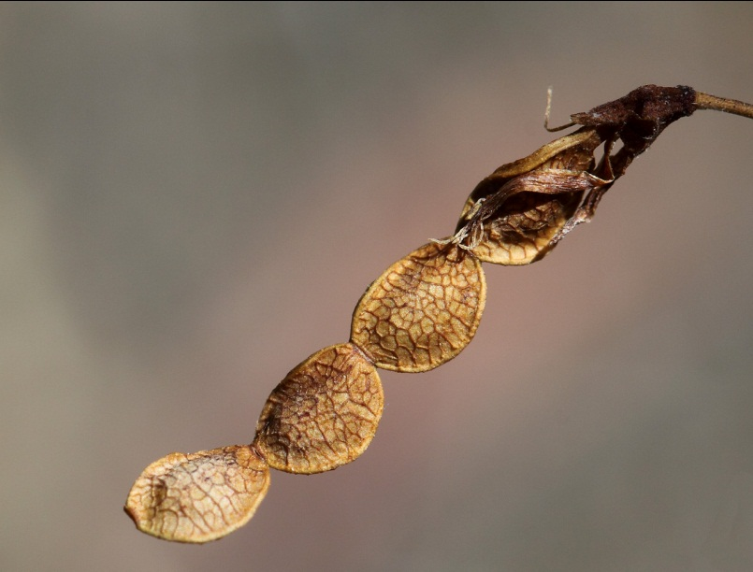
Legumes– always from 1 carpel
Loment

Slide 33
Fruit Dehiscent, Dry, Two or More Carpels
Schizocarp– fruit from a 2 to many carpellate gynoecium that splits into segments (splits between carpels) that then release the seeds (1-many seeds).
Nutlets– small, dry, dehiscent fruit that splits between and through carpels.
Capsule– fruit from a 2 to many carpellate gynoecium that splits to release seeds immediately. Includes many types– loculicidal, septicidal, denticidal, etc.

Slide 34



Schizocarps– Geranium caespitosum

Slide 35



Schizocarps– Malva neglecta

Slide 36


Nutlets
Cryptantha pterocarya
Stachys coccinea

Slide 37

Capsules
Loculicidal
Septicidal

Slide 38


Capsules
Loculicidal
Septicidal

Slide 39


Capsules
Denticidal
Poricidal
Circumscissile
Portulaca suffrutescens
Mentzelia multiflora (dehisces by apical valves)

Slide 40
Aggregate Fruits
Aggregate fruit: a fruit forming as the result of fusion of carpels from a SINGLE (A-ggregate) flower. Examples: strawberry is an aggregate of achenes, raspberry an aggregate of drupes. Magnolia is an aggregate of follicles.

Slide 41


Strawberry: an aggregate of achenes

Slide 42


Rose: an aggregate of achenes!

Slide 43
Multiple Fruits
M-ultiple fruit: a fruit formed by the gynoecia of m-any closely clustered flowers.
Pineapple (Ananas) is a multiple of berries
Mulberry (Morus) is a multiple of drupes
Sycamore (Platanus) is a multiple of achenes

Slide 44


Maclura pomifera: a M (for many)-ultiple of drupes

Slide 45


Morus microphylla

Slide 46


Platanus wrightii: a multiple of achenes

Slide 47

Seeds
Origin of Endosperm
Origin of Seed Coat

Slide 48

Seeds

Slide 49


Aril: brightly colored outgrowth or thickening of the seed coat
Water laden seed coat is edible
Q: what type of fruit is this?

Slide 50
Time to Take a Virtual Tour of Walmart’s Produce Section
(Fruits and Nuts)

